Slide 1

ELECTVIZ: ELECTION DATA VISUALIZATION FOR MEDIA
PRESENTED BY : ANGAMMAL R
Notes:
1

Slide 2
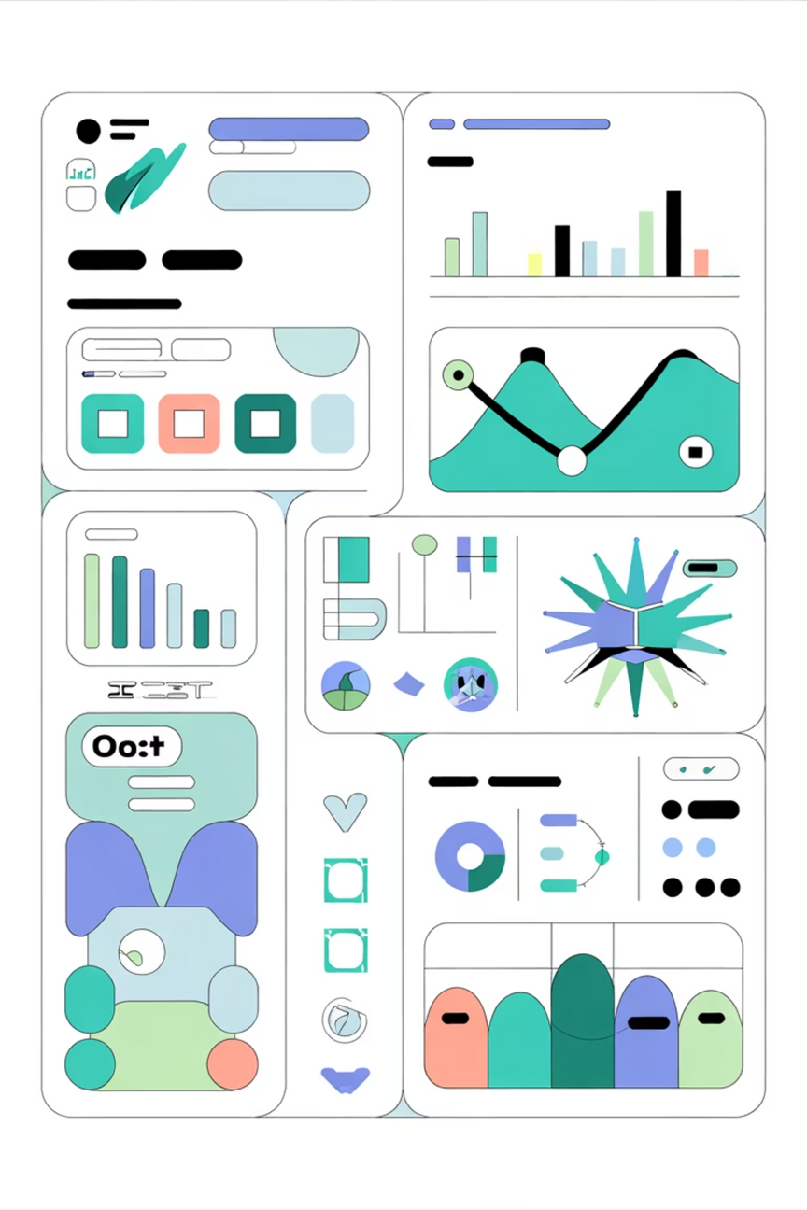
The Challenge: Making Election Data Accessible
Complex Electoral Landscape
Managing data across 28 states, 8 union territories, 543 constituencies, and millions of voters demands a unified analytical framework to identify patterns and performance metrics across diverse regions.
Audience Needs
Policymakers, analysts, and citizens require intuitive dashboards that reveal voting trends, party performance, regional participation, and voting method reliability without overwhelming complexity.
Notes:
2

Slide 3

ElectViz Architecture: Building the Foundation
A comprehensive data pipeline that transforms raw election data into actionable intelligence through systematic processing and sophisticated modelling.
Collect Data
Prepare Data
Model Data
Visualize
Each layer builds upon the previous, ensuring data integrity and enabling multi-dimensional analysis across states, parties, candidates, and voting methods.
Notes:
3

Slide 4
Phase-wise Election Analysis Across Seven Phases
Detailed visualization of voter participation patterns across India's seven election phases, tracking turnout variations, regional engagement, and polling percentages by state.
Phase 1
1
Polling across 20 states/UTs and 91 constituencies.
Covers diverse constituencies, including North-East, southern regions, and parts of Uttar Pradesh.
Sets the election tone, focusing on voter enthusiasm in varied landscapes.
2
Phase 2
Polling across 13 states/UTs and 97 constituencies.
Significant polling increase in Uttar Pradesh, Bihar, Karnataka, and Maharashtra.
Phase 3
3
Polling across 14 states/UTs and 115 constituencies.
Turnout patterns indicate voter sentiment across demographics, reflecting intensified campaigning.
Features polling in states like Gujarat and Kerala, covering substantial seats.
4
Phase 4
Mid-election turnout provides a crucial snapshot of public mood and party strategy effectiveness.
Polling across 9 states/UTs and 71 constituencies.
Peak electoral activity in Andhra Pradesh, Telangana, Rajasthan, and Madhya Pradesh.
Phase 5
5
Polling across 7 states/UTs and 51 constituencies.
High turnout often signals competitive contests and strong regional issues.
Polling in Uttar Pradesh, Bihar, and politically sensitive Jammu & Kashmir.
6
Phase 6
Strategic importance lies in consolidating support in crucial battleground states.
Polling across 7 states/UTs and 59 constituencies.
Focus shifts to northern momentum, with Delhi, Haryana, and remaining Uttar Pradesh and Bihar constituencies.
Phase 7
7
Vital for national parties, involving high-stakes contests in urban centers and the Hindi heartland.
Polling across 8 states/UTs and 59 constituencies.
The final phase, covering Punjab, Himachal Pradesh, and last seats in Uttar Pradesh, Bihar, and West Bengal.
Turnout reflects culmination of extensive campaigning efforts.
Often includes high-profile constituencies, some involving the Prime Minister.
"Finale intensity" aims to maximize turnout, determining the last pieces of the electoral puzzle.
Notes:
4

Slide 5
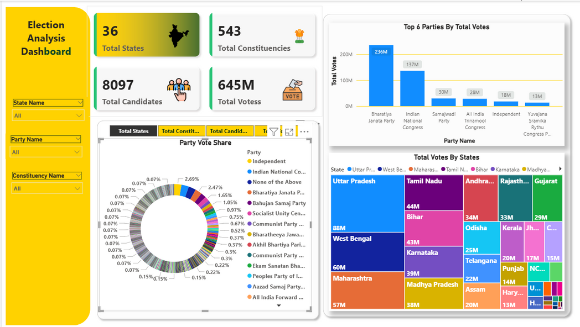
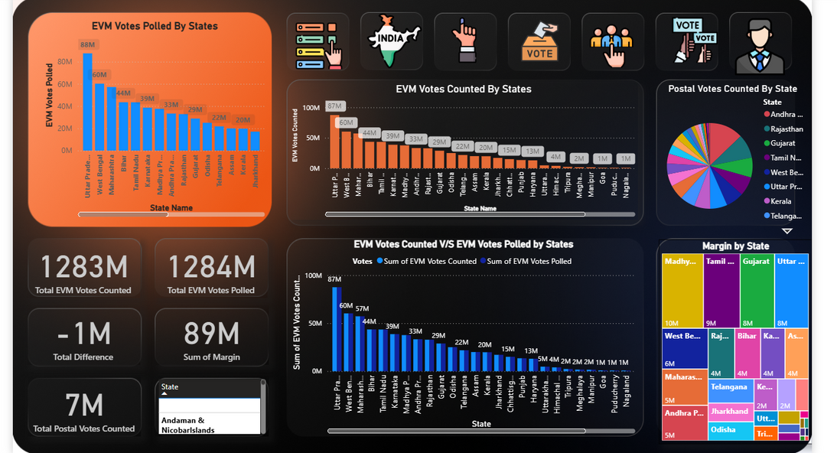
Dashboard Snapshots

Slide 6
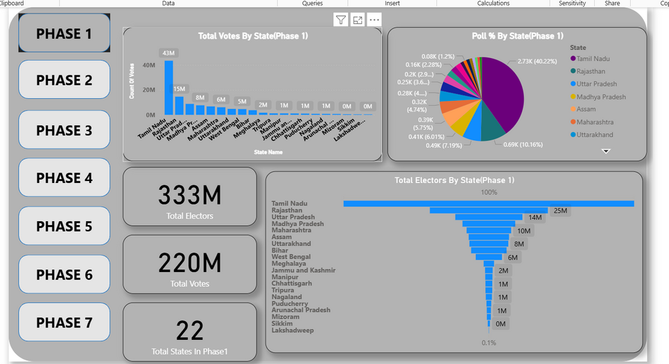
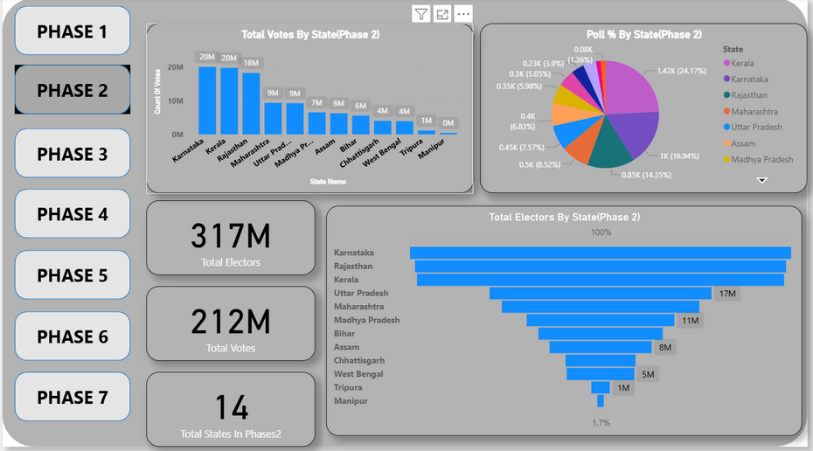
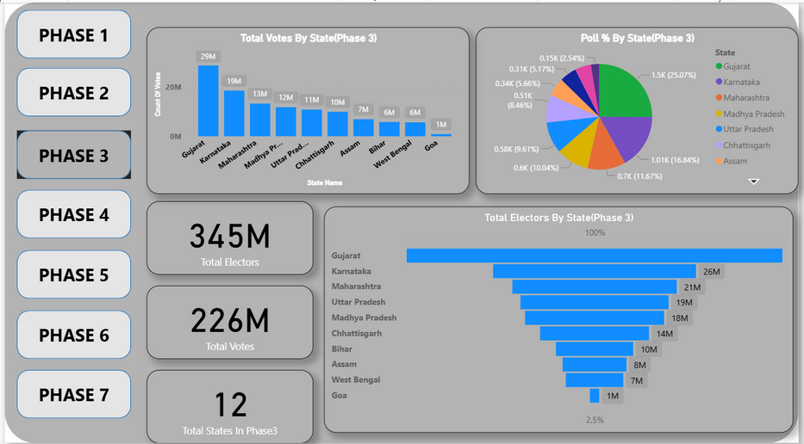

Slide 7
Advantages and Disadvantages
1
Real-time Data Integration
2
Multi-dimensional Filtering
Automatically aggregates and updates electoral data across all states and constituencies, eliminating manual compilation delays and ensuring analysis currency.
Users drill down by state, party, constituency, and voting method to uncover granular insights and identify regional voting behaviors and preferences.
3
Transparency and Trust
4
Actionable Intelligence
Comparative analysis of EVM versus postal voting validates electoral integrity and builds public confidence through transparent methodology and data visualization.
Consolidates complex datasets into intuitive dashboards enabling policymakers, analysts, and citizens to make informed decisions and understand democratic participation patterns.
Notes:
5

Slide 8
Future Enhancements
1
2
3
Predictive Analytics
Swing Analysis Engine
AI-Powered Insights
Regression models forecasting voter turnout and party performance trends
Identify constituencies changing party alignment with detailed historical comparison
Natural language summaries and anomaly detection for automatic pattern discovery
4
5
Geo-Visual Enhancement
Citizen Engagement
Interactive maps with real-time tooltips and demographic overlays
Mobile optimization, voter education widgets, and feedback mechanisms for participation
Notes:
6

Slide 9
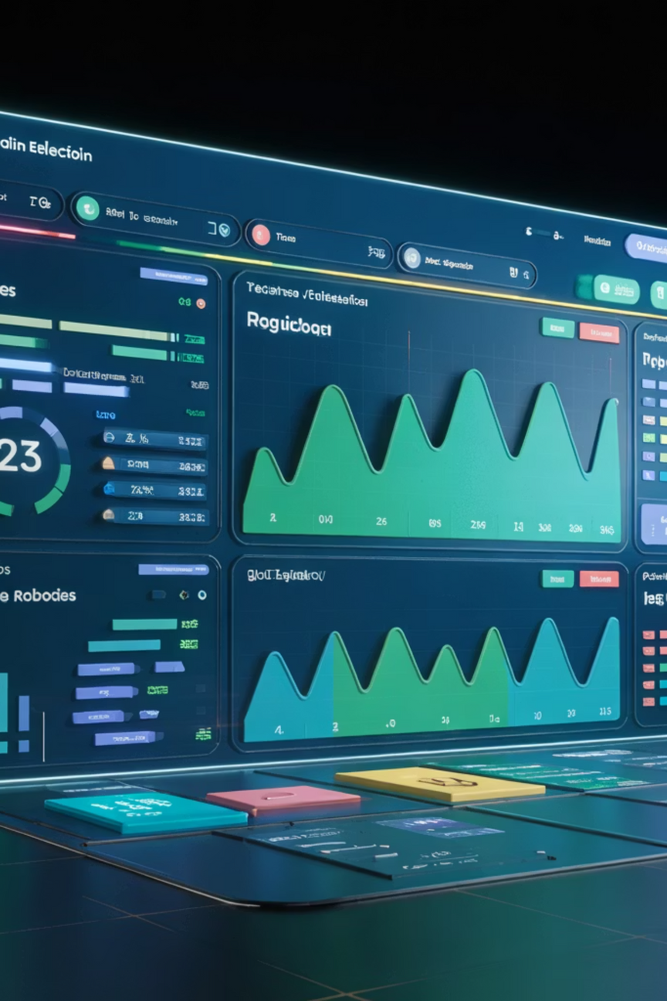
Current Limitations and Future Vision
Present Constraints
Advanced Future Capabilities
Static historical data requiring manual updates
Live streaming dashboards during election phases
Limited real-time monitoring during active phases
Constituency-level granularity and constituency-wise trend analysis
Predictive analytics capabilities underdeveloped
Machine learning models predicting voting behavior and outcomes
Geographic visualization scope limited to state level
Social media sentiment integration revealing public opinion dynamics
Notes:
7

Slide 10
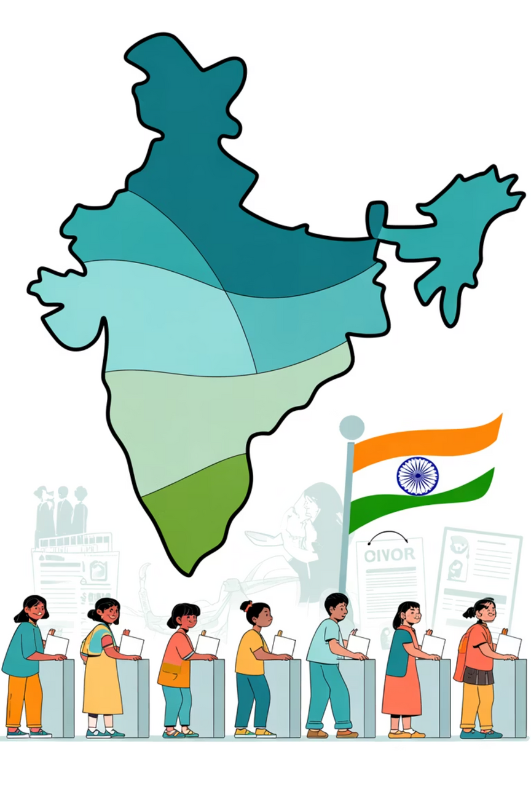

Thank You
ElectViz: Making Indian Elections Transparent, Accessible, and Insightful
Notes:
8

